Slide 1



Left Recursion And Left Factoring

Slide 2
Why use regular expressions to define the lexical syntax of a language?
There are several reasons:
1. Separating the syntactic structure of a language into lexical and non-lexical parts provides a convenient way of modularizing the front end of a compiler into two manageable-sized components.
2. The lexical rules of a language are frequently quite simple, and to describe them we do not need a notation as powerful as grammars.
3. Regular expressions generally provide a more concise and easier-to-understand notation for tokens than grammars.
4. More efficient lexical analyzers can be constructed automatically from regular expressions than from arbitrary grammars.

Slide 3
Lexical Versus Syntactic Analysis
There are no firm guidelines as to what to put into the lexical rules, as opposed to the syntactic rules. Regular expressions are most useful for describing the structure of constructs such as identifiers, constants, keywords, and white space. Grammars, on the other hand, are most useful for describing nested structures such as balanced parentheses, matching begin-end's, corresponding if-then-else's, and so on. These nested structures cannot be described by regular expressions.

Slide 4

Eliminating Ambiguity
Sometimes an ambiguous grammar can be rewritten to eliminate the ambiguity.
As an example, we shall eliminate the ambiguity from the following "dangling else" grammar:
Here "other" stands for any other statement. According to this grammar, the compound conditional statement.

Slide 5
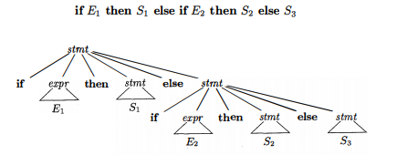
Eliminating Ambiguity

Slide 6
Elimination of Left Recursion
A grammar is left recursive if it has a nonterminal A such that there is a
derivation A → Aa for some string a. Top-down parsing methods cannot handle left-recursive grammars, so a transformation is needed to eliminate left recursion.
We showed how the left-recursive pair of productions A → Aa | B could be replaced by the non-left-recursive productions:
A → B A’
A’ → a A’ | E
Without changing the strings derivable from A. This rule by itself suffices for many grammars.

Slide 7


Elimination of Left Recursion
After eliminating left recursion non-left-recursive expression grammar

Slide 8
Elimination of Left Recursion
Description of above solved example:
The left-recursive pair of productions
E → E + T I T are replaced by
E → T E'
and E‘ → T E' I E.
The new productions for T and T' are obtained similarly by eliminating immediate left recursion.

Slide 9
Rules of Elimination of Left Recursion
If we have the left-recursive pair of productions:
A → Aα / β
(Left Recursive Grammar)
where β does not begin with an A.
Then, we can eliminate left recursion by replacing the pair of productions with
A → βA’
A’ → αA’ / ∈

Slide 10




Elimination of Left Recursion
Consider the grammar
We order the nonterminals: S < A. There is no left recursive S-productions. So the next step is to remove S from the right-hand side of the A-productions of the form A → Sa. Hence we obtain

Slide 11



Elimination of Left Recursion
Then we remove the left recursive A-productions.

Slide 12
Elimination of Left Recursion Example
Consider the following grammar and eliminate left recursion-
E → E + E / E x E / a
Solution
The grammar after eliminating left recursion is:
E → aA
A → +EA / xEA / ∈

Slide 13
Elimination of Left Recursion Example
Consider the following grammar and eliminate left recursion-
E → E + T / T
T → T x F / F
F → id
Solution:
The grammar after eliminating left recursion is:
E → TE’
E’ → +TE’ / ∈
T → FT’
T’ → xFT’ / ∈
F → id

Slide 14
Left Factoring
Left factoring is a grammar transformation that is useful for producing a grammar suitable for predictive, or top-down, parsing. When the choice between two alternative A-productions is not clear, we may be able to rewrite the productions to defer the decision until enough of the input has been seen that we can make the right choice.
For example, if we have the two productions
stmt → if expr then stmt else stmt | if expr then stmt

Slide 15
Example
The following grammar abstracts the "dangling-else" problem:
S → i E t S | i E t S e S | a
E → b
Here, i, t, and e stand for if, then, and else; E and S stand for "conditional expression" and "statement." Left-factored, this grammar becomes:
S → i E t S S’ | a
S’ → e S | ∈
Thus, we may expand S to iEtSS' on input i, and wait until iEtS has been
seen to decide whether to expand S' to eS or to ∈. Of course, these grammars are both ambiguous, and on input e, it will not be clear which alternative for S' should be chosen.

Slide 16
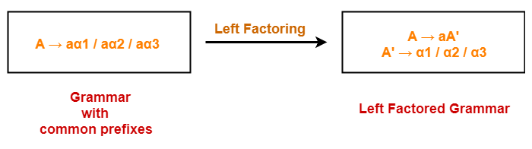
Left Factoring Example

Slide 17
Left Factoring Example
Do left factoring in the following grammar-
A → aAB / aBc / aAc
Solution-
Step-01:
A → aA’
A’ → AB / Bc / Ac
Again, this is a grammar with common prefixes.
Step-02:
A → aA’
A’ → AD / Bc
D → B / c
This is a left factored grammar.

Slide 18
Transition Diagrams for Predictive Parsers
Transition diagrams are useful for visualizing predictive parsers.
Transition diagrams for predictive parsers differ from those for lexical analyzers. Parsers have one diagram for each nonterminal. The labels of edges can be tokens or nonterminals. A transition on a token (terminal) means that we take that transition if that token is the next input symbol. A transition on a nonterminal A is a call of the procedure for A.

Slide 19
No recursive Predictive Parsing
A non recursive predictive parser can be built by maintaining a stack explicitly, rather than implicitly via recursive calls. The parser mimics a leftmost derivation. If w is the input that has been matched so far, then the stack holds a sequence of grammar symbols a such that

Slide 20
No recursive Predictive Parsing
The parser is controlled by a program that considers X, the symbol on top of the stack, and a, the current input symbol. If X is a nonterminal, the parser chooses an X-production by consulting entry M[X, a] of the parsing table M.
(Additional code could be executed here, for example, code to construct a node in a parse tree.) Otherwise, it checks for a match between the terminal X and current input symbol a.
The behavior of the parser can be described in terms of its configurations, which give the stack contents and the remaining input.

Slide 21
Thank You

